Slide 1
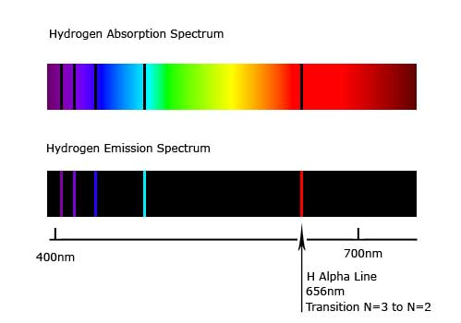
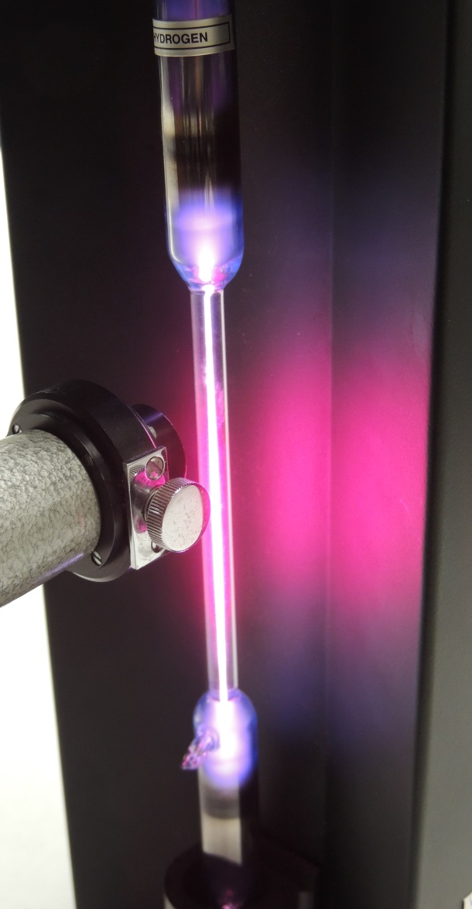
PHYS 365
Experiment 4
Hydrogen Balmer Series

Slide 2
Objective
To learn how to calibrate a spectroscope
To determine experimental values of:
  diffraction grating spacing
  wavelengths in the Balmer series
  Rydberg constant
  Ionization energy of Hydrogen

Slide 3
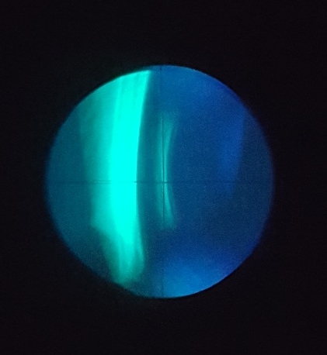



Spectral lines
Every line is an image of the slit – narrow and rectangular in shape
Blue- violet
Blue- green (cyan)
Red
Reflection
Notes:
In this

Slide 4
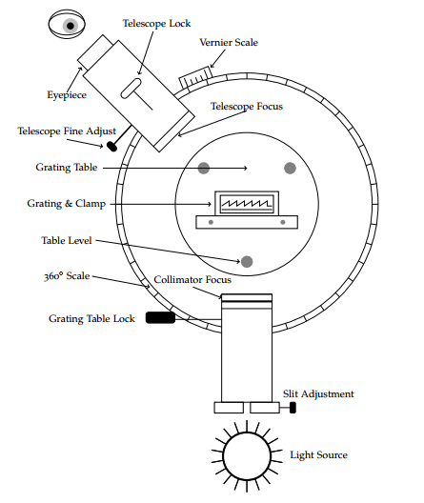
Equipment
adjust the grating table (usually 0.2º is enough) if your angle on the left deviates too much (1º) to your right angle

Slide 5
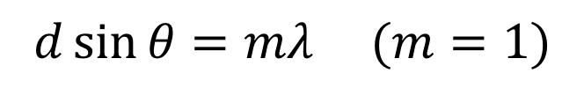
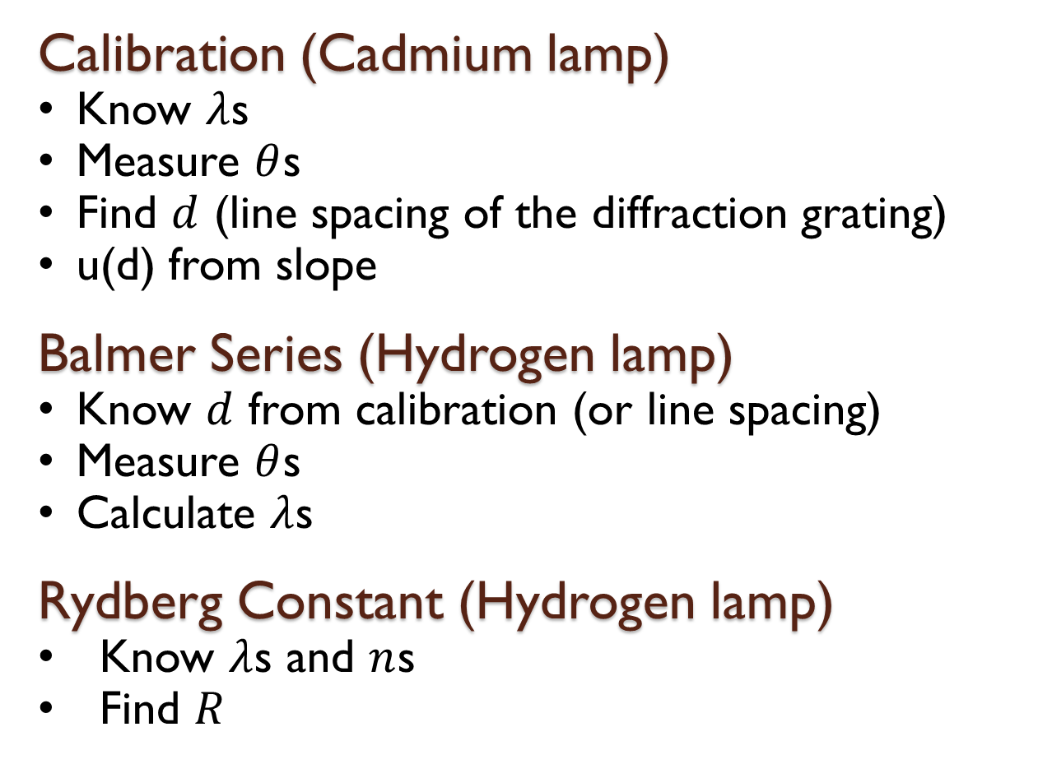
Procedure
$$d\sin{θ=mλ (m=1)}$$
Calibration (Cadmium lamp)
Know $λ$s
Measure $θ$s
Find $d$ (line spacing of the diffraction grating)
u(d) from slope
Balmer Series (Hydrogen lamp)
Know $d$ from calibration (or line spacing)
Measure $θ$s
Calculate $λ$s
Rydberg Constant (Hydrogen lamp)
Know $λ$s and $n$s
Find $R$
Notes:
There is a section named ‘Calculation of uncertainties in the write up’
Please read that carefully

Slide 6
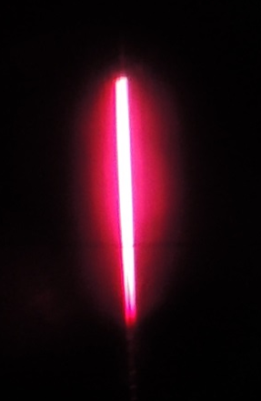
Calibration
Make the adjustments and calibrate the spectroscope (see lab write-up)
For maximum sensitivity ensure that as much light enters the spectroscope through the aperture (slit) as possible
Maximize the intensity of the central maximum by positioning the collimator (slit) directly in front of the light source

Slide 7

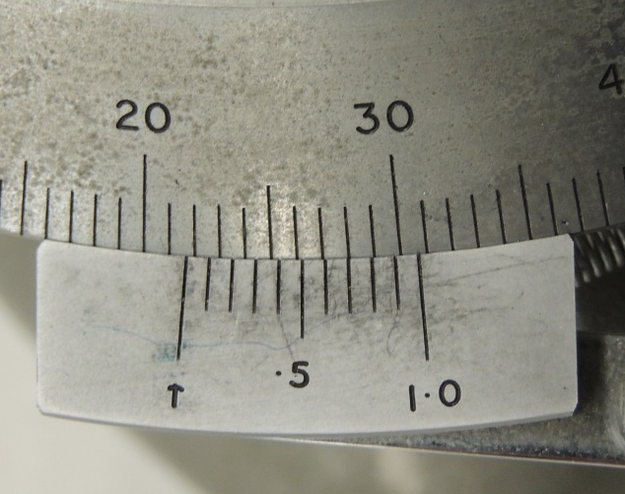
Procedure
Measure the position of 4 pairs of equivalent lines to the left and to the right of the central maximum (for lines in first order)
Make sure that you can see the crosshairs before reading the angle
21.7⁰

Slide 8
Warning
Turn off the discharge tube as soon as your measurements of the hydrogen spectrum are completed
Cadmium lamp should warm up about 15 min
Do not touch or clear any of the lenses or diffraction grating

Slide 9
Lab data template
Demonstrate to your TA that you’ve calibrated the spectroscope before measuring Hydrogen Balmer Series
Use excel template from D2L to record all data and do calculations.
For the line fitting part, please use the template from D2L (line fitting template), save the plots for your lab report.
Upload all the excels to D2L

Slide 10
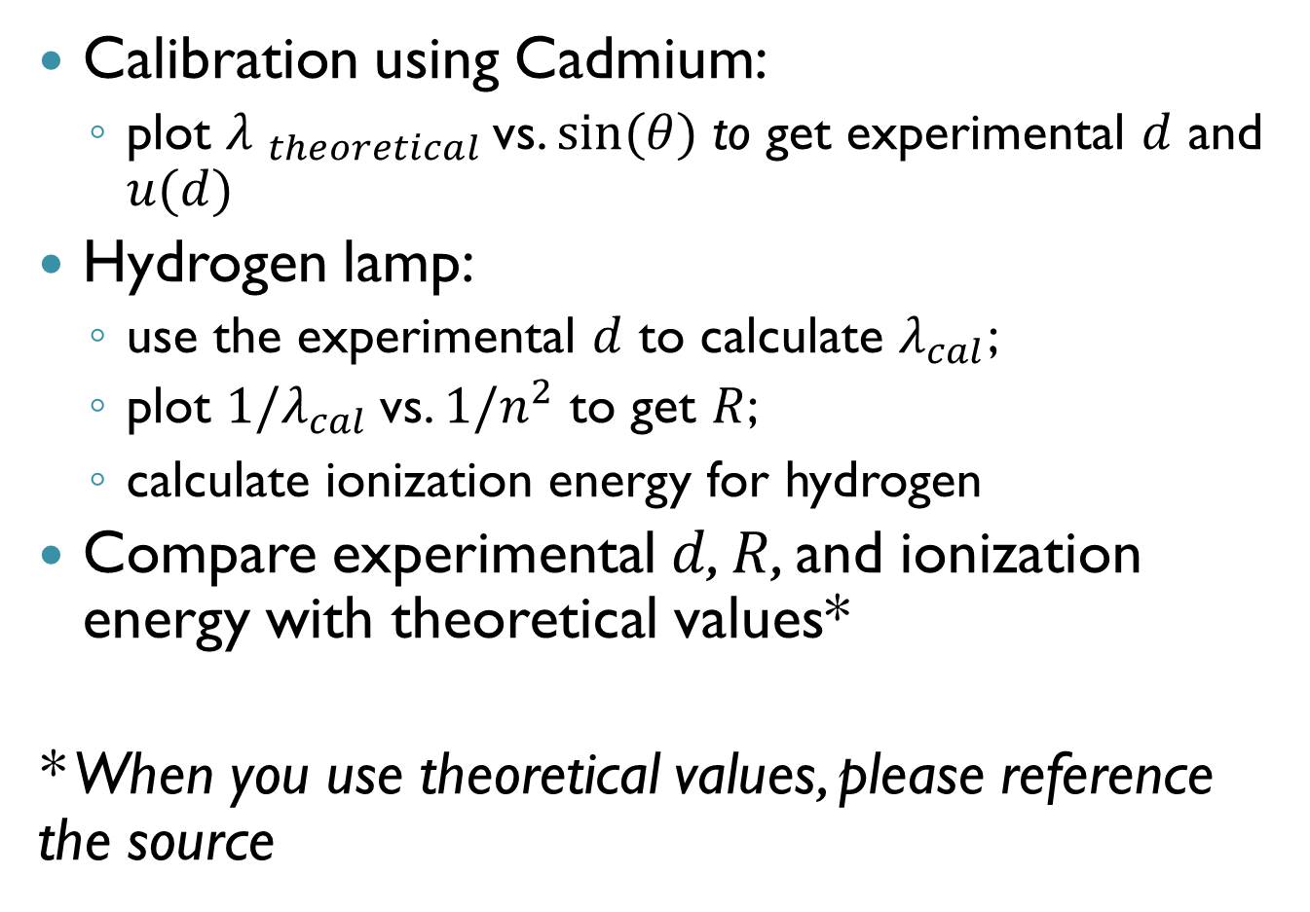
Data Analysis
Calibration using Cadmium:
  plot ${λ }_{theoretical }$vs. $sin(θ)$ to get experimental $d$ and $u(d)$
Hydrogen lamp:
  use the experimental $d$ to calculate $λ_{cal}$;
  plot ${1/λ_{cal}}_{ }$vs. $1/n^{2}$to get $R$;
  calculate ionization energy for hydrogen
Compare experimental $d$, $R$, and ionization energy with theoretical values*
* When you use theoretical values, please reference the source
Notes:
Ionization energy : how is it defined (the energy it takes to remove the electron from n =1 to n =inf)

Slide 11
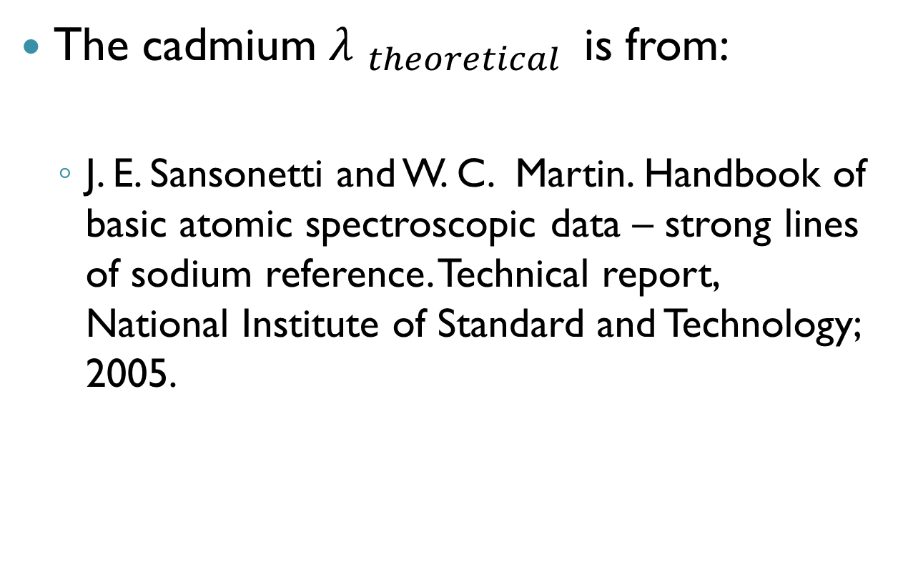
Reference
The cadmium ${λ }_{theoretical }$ is from:
  J. E. Sansonetti and W. C. Martin. Handbook of basic atomic spectroscopic data – strong lines of sodium reference. Technical report, National Institute of Standard and Technology; 2005.

